Slide 1


Tinder Trails No Sparks allowed
Chris Hernandez, Claudia Caceres
Joe Gorfinkle, Wan-Fang Chou
IST 303 Software Development
February 11, 2019

Slide 2
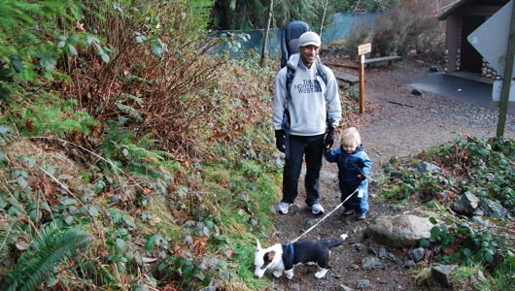
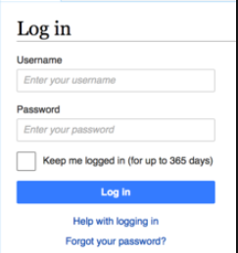

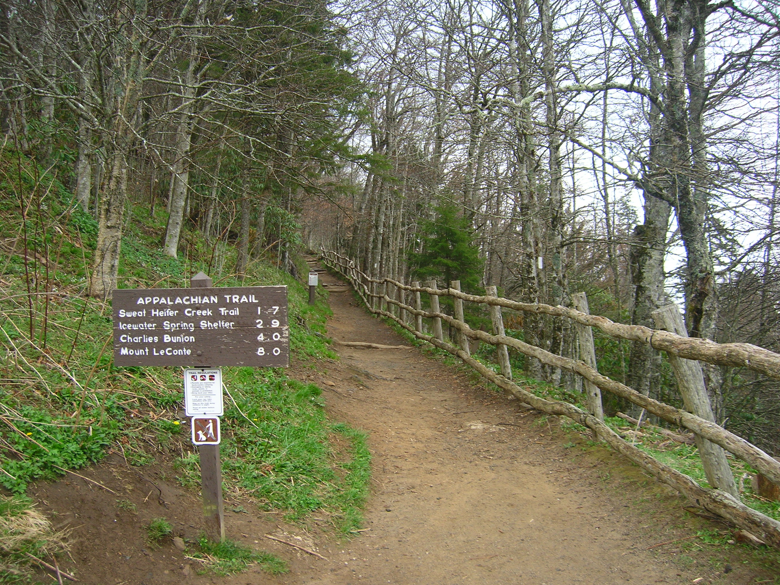
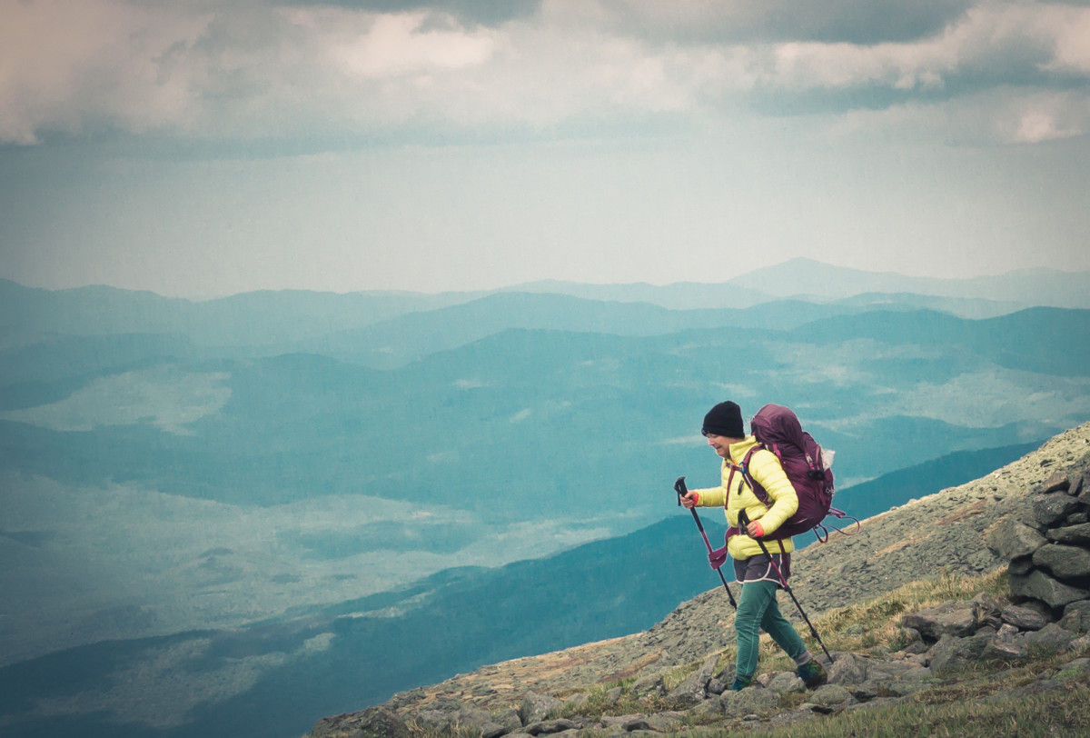


MAIN PAGE
User selects
1 of 4
Child/Dog Friendly
Nearby
Your Spec
Equipment

Slide 3
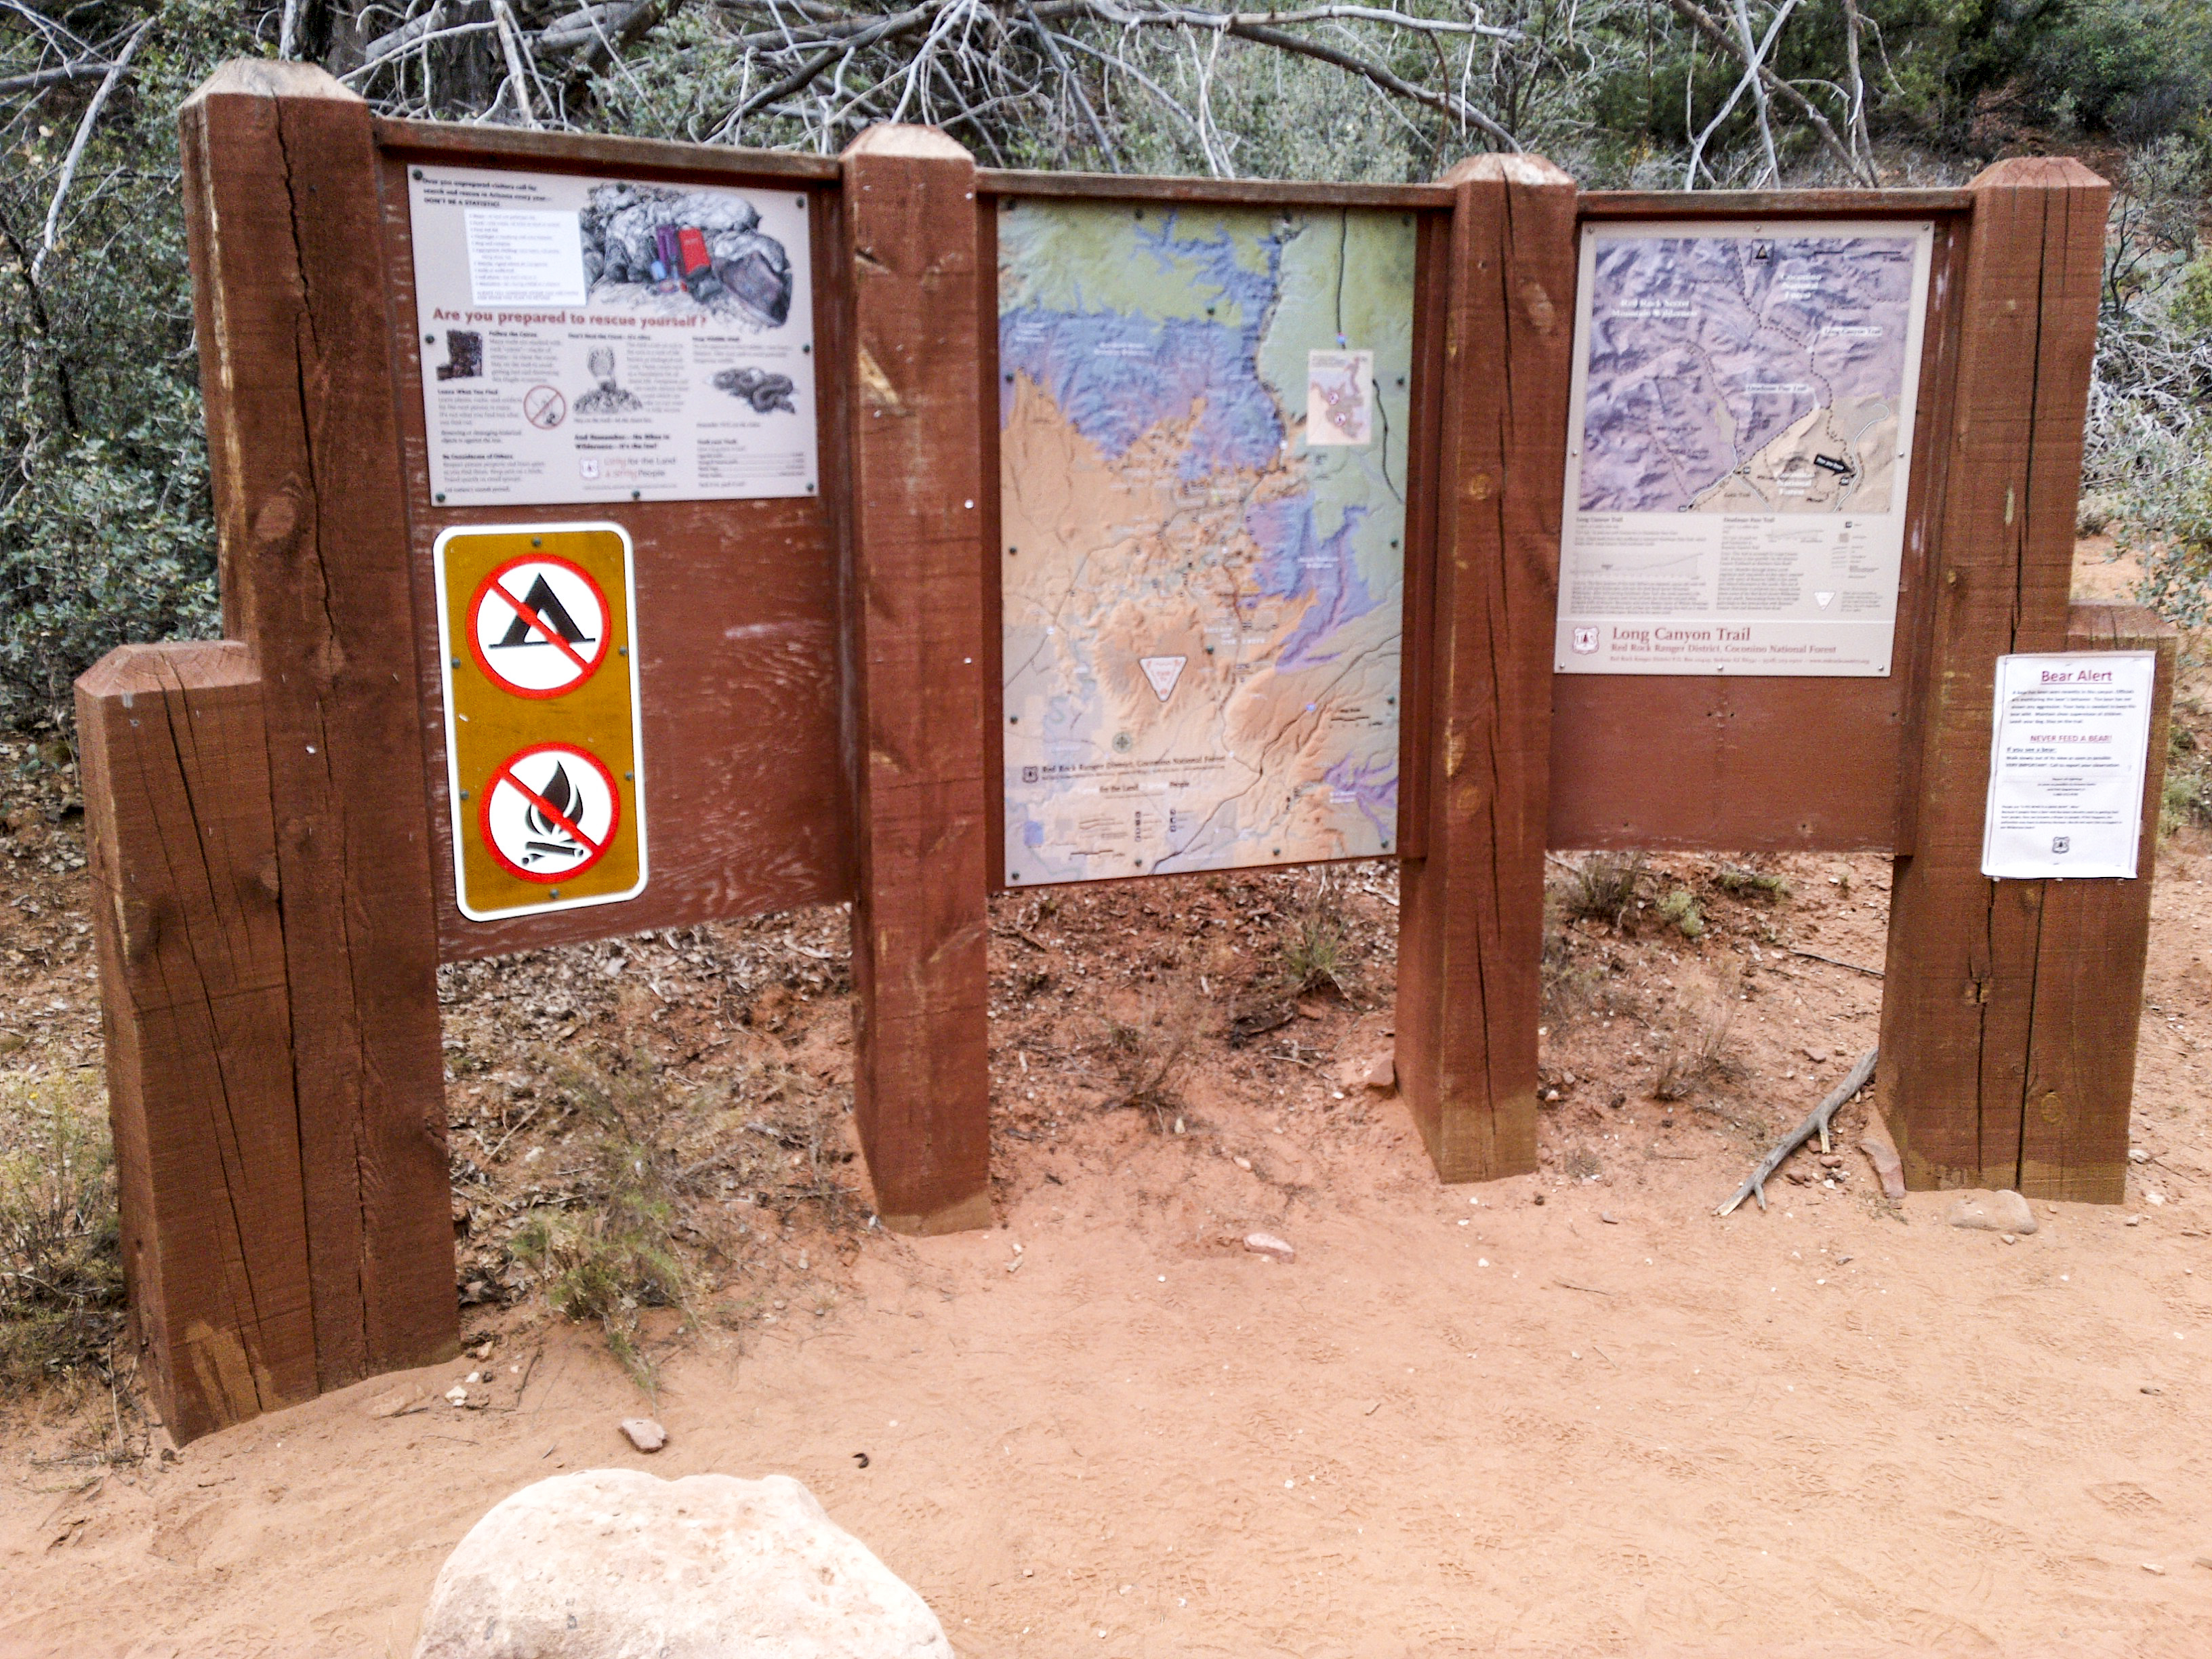
TRAIL INFORMATION PAGE
TRAIL NAME
- length (meters, miles)
- difficulty (easy, moderate, difficult)
- average slope
- total elevation rise
- peak elevation
- estimated round trip time
- reviews/ratings
- mountain bikes / motorized vehicles prohibited

Slide 4









TRAIL AMENITY PAGE

Slide 5






DEVELOPMENT
ENVIRONMENT

Slide 6
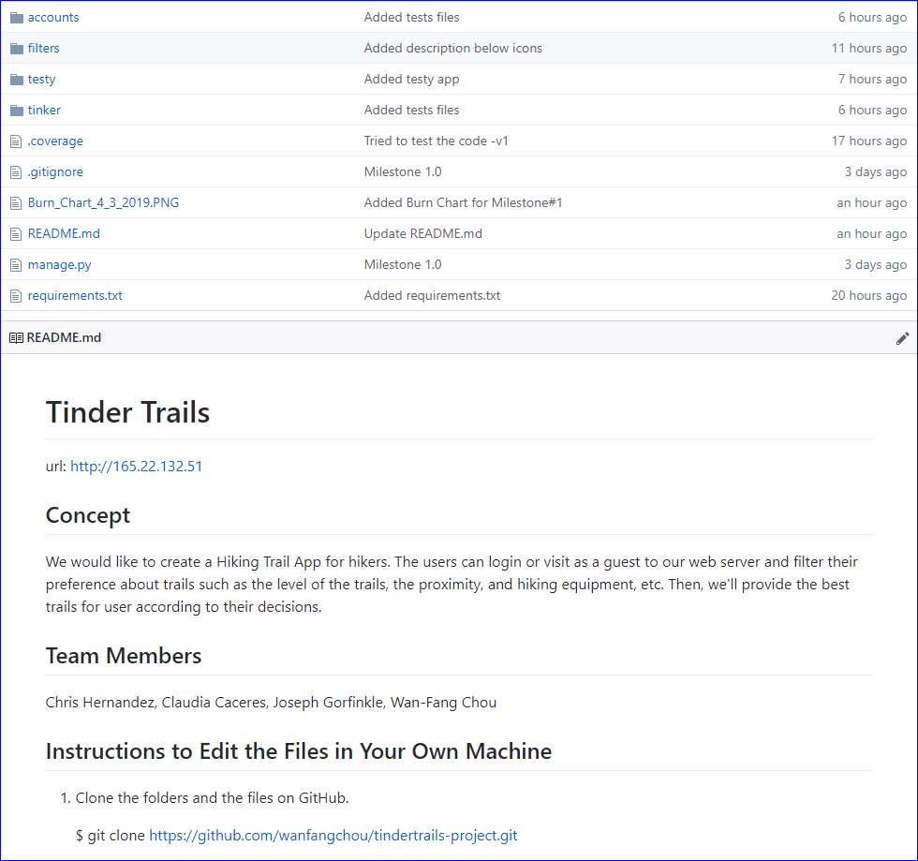
GitHub

Slide 7
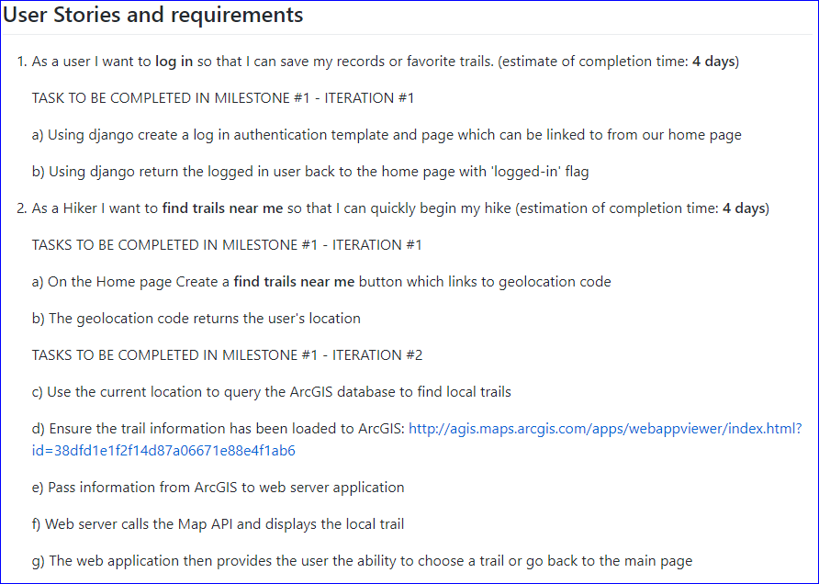
Milestone #1 – 2 user stories, 10 tasks

Slide 8
Demo Django Login & ArcGIS connector & code walk through
http://165.22.132.51/
Demo Hiking Trail Features & code walk through

Slide 9
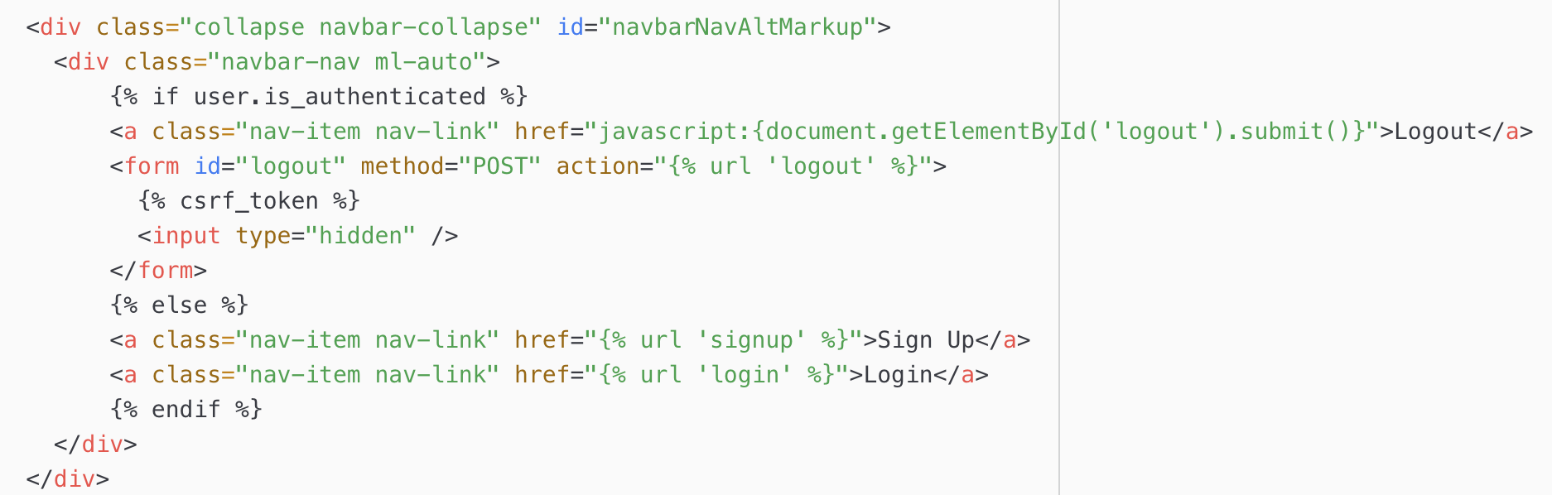
Django code walk through US_1a_Using Django to create sign up, login and log out
(tindertrails-project/tinker/templates/base.html)
Navigation bar

Slide 10
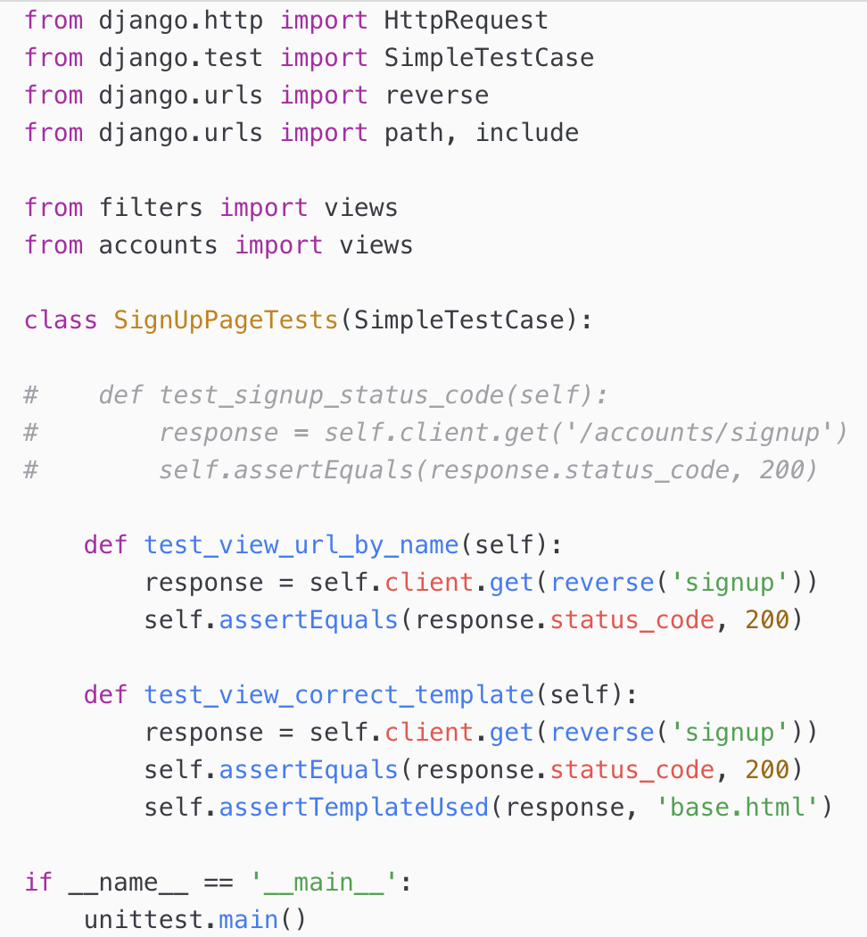
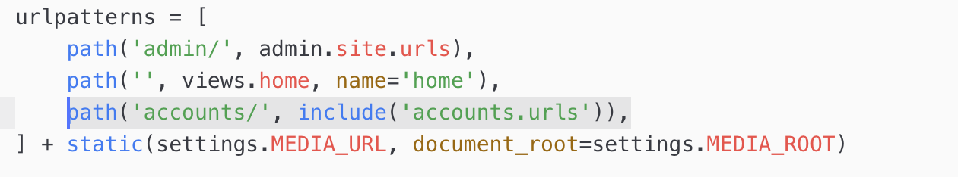
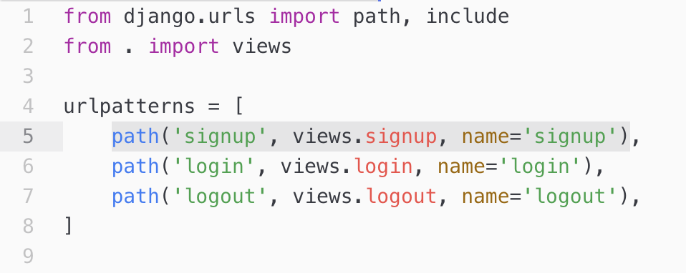
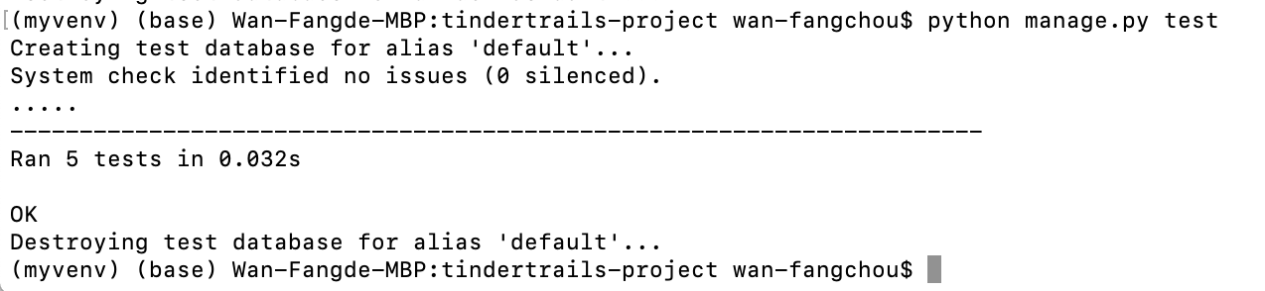
Django code walk through and test US_1a_Using Django to create sign up, login and log out
Test
Sign Up
Sign Up url: http://165.22.132.51/accounts/signup
(tindertrails-project/tinker/urls.py)
(tindertrails-project/accounts/urls.py)

Slide 11
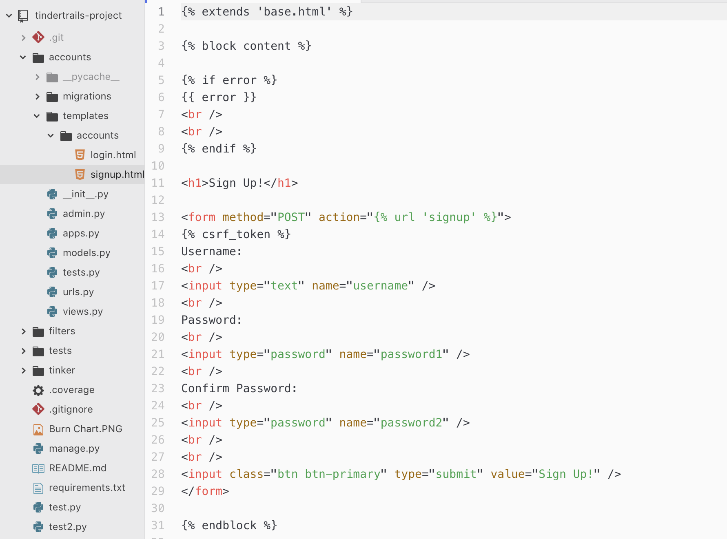
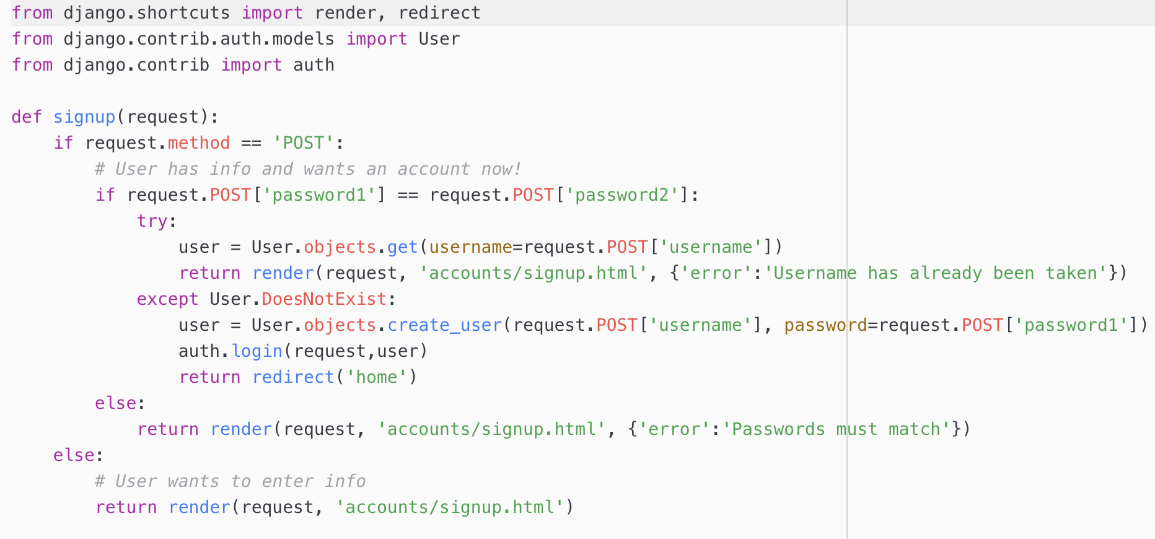
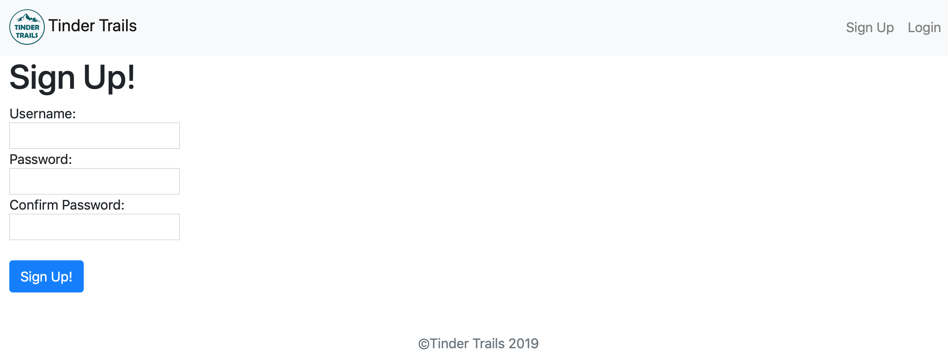
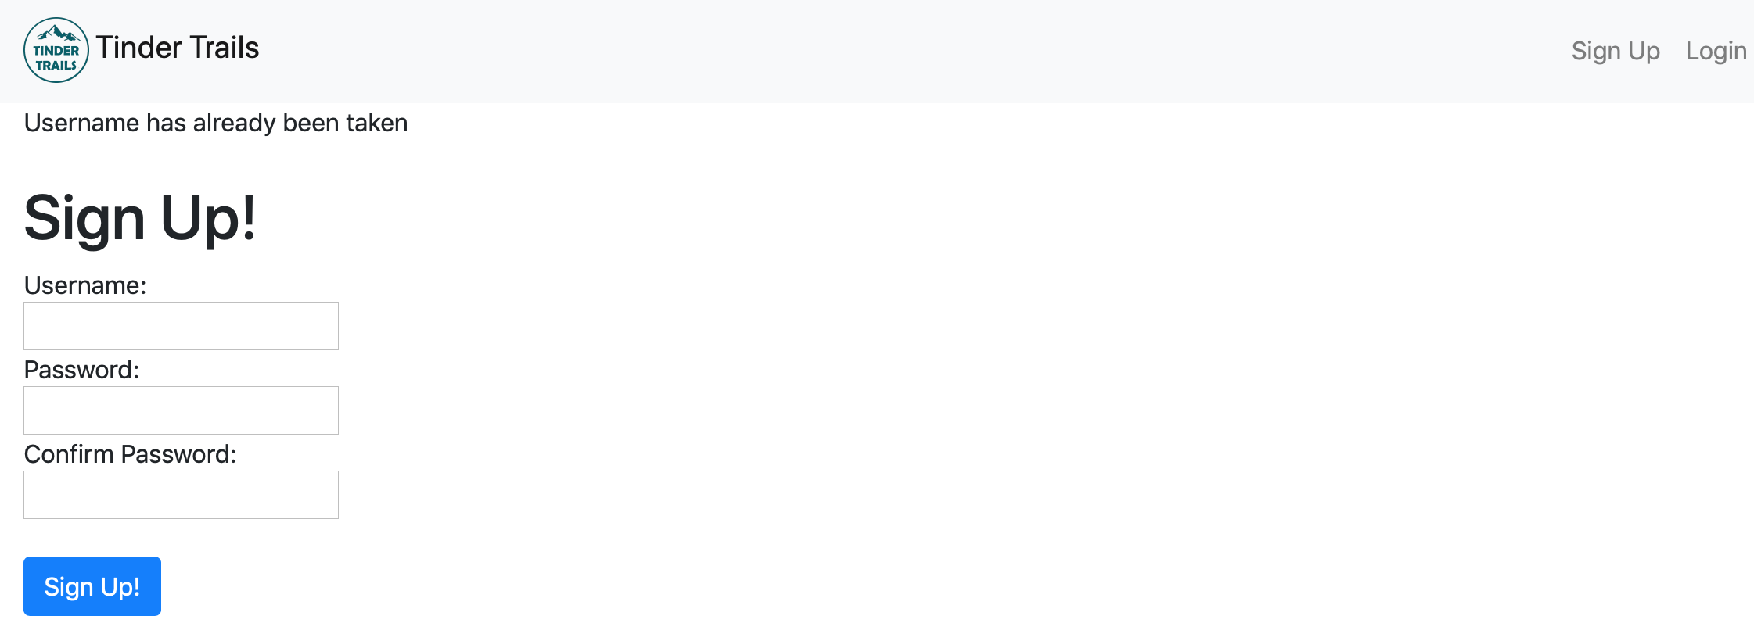
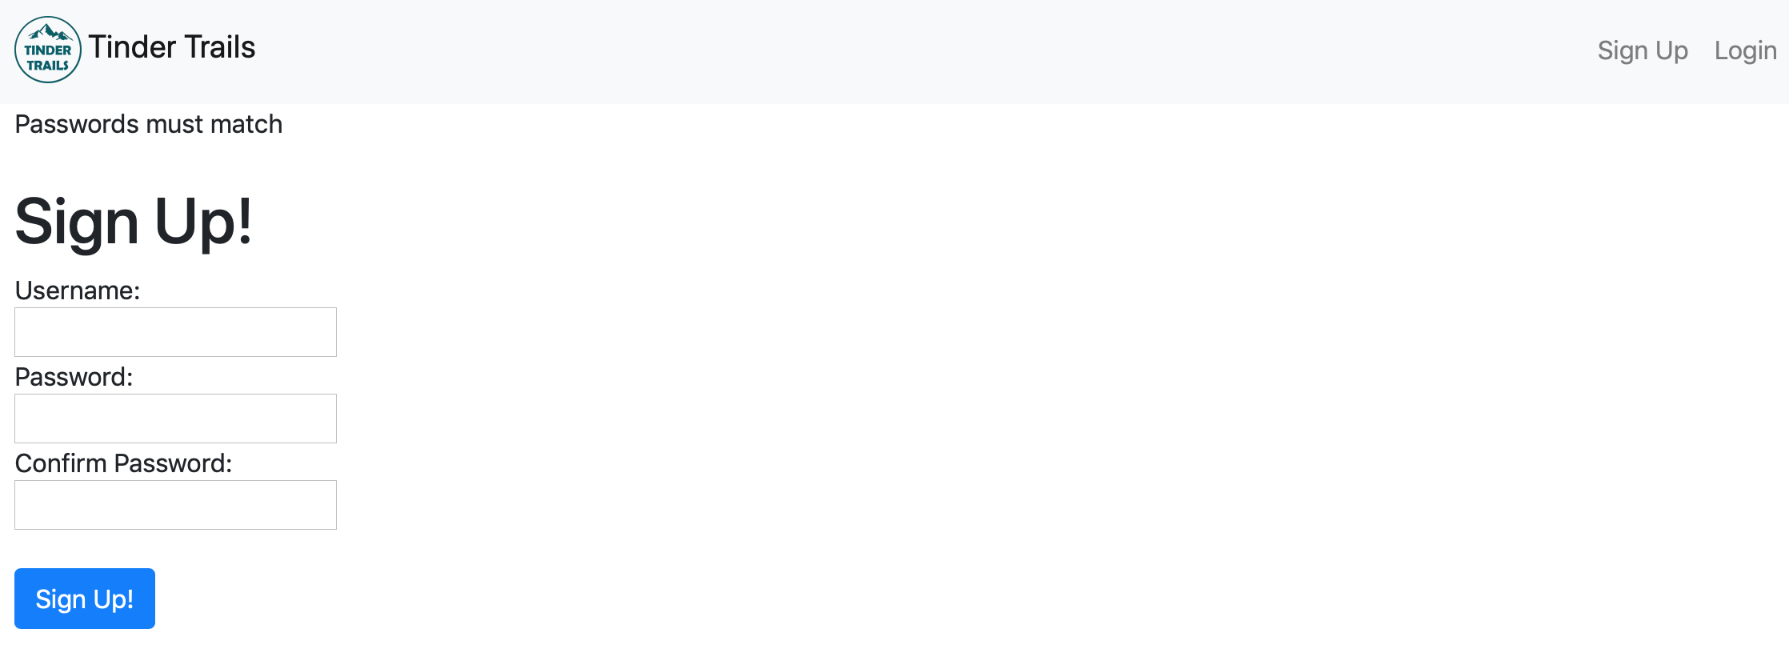
Django code walk through US_1a_Using Django to create sign up, login and log out
Sign Up
(accounts/templates/accounts/signup.html)
(tindertrails-project/accounts/views.py)

Slide 12
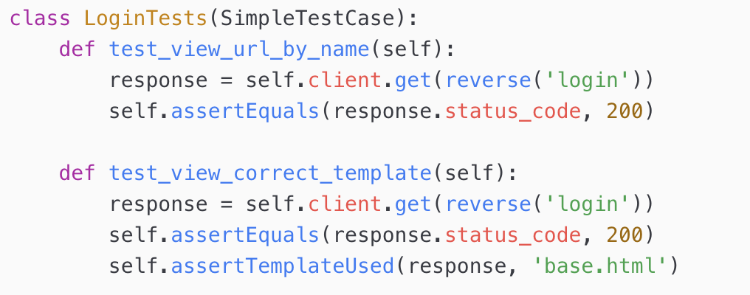
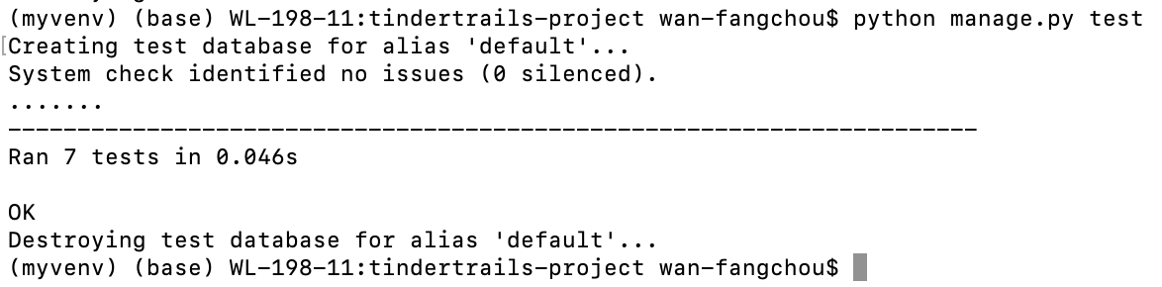
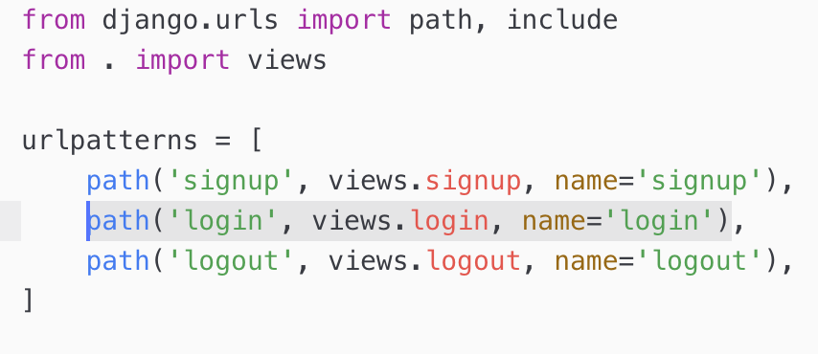
Django code walk through and test US_1a_Using Django to create sign up, login and log out US_1b_Send users back once they logged in or log out
Login
Test
Login url: http://165.22.132.51/accounts/login
(tindertrails-project/tinker/urls.py)
(tindertrails-project/accounts/urls.py)

Slide 13
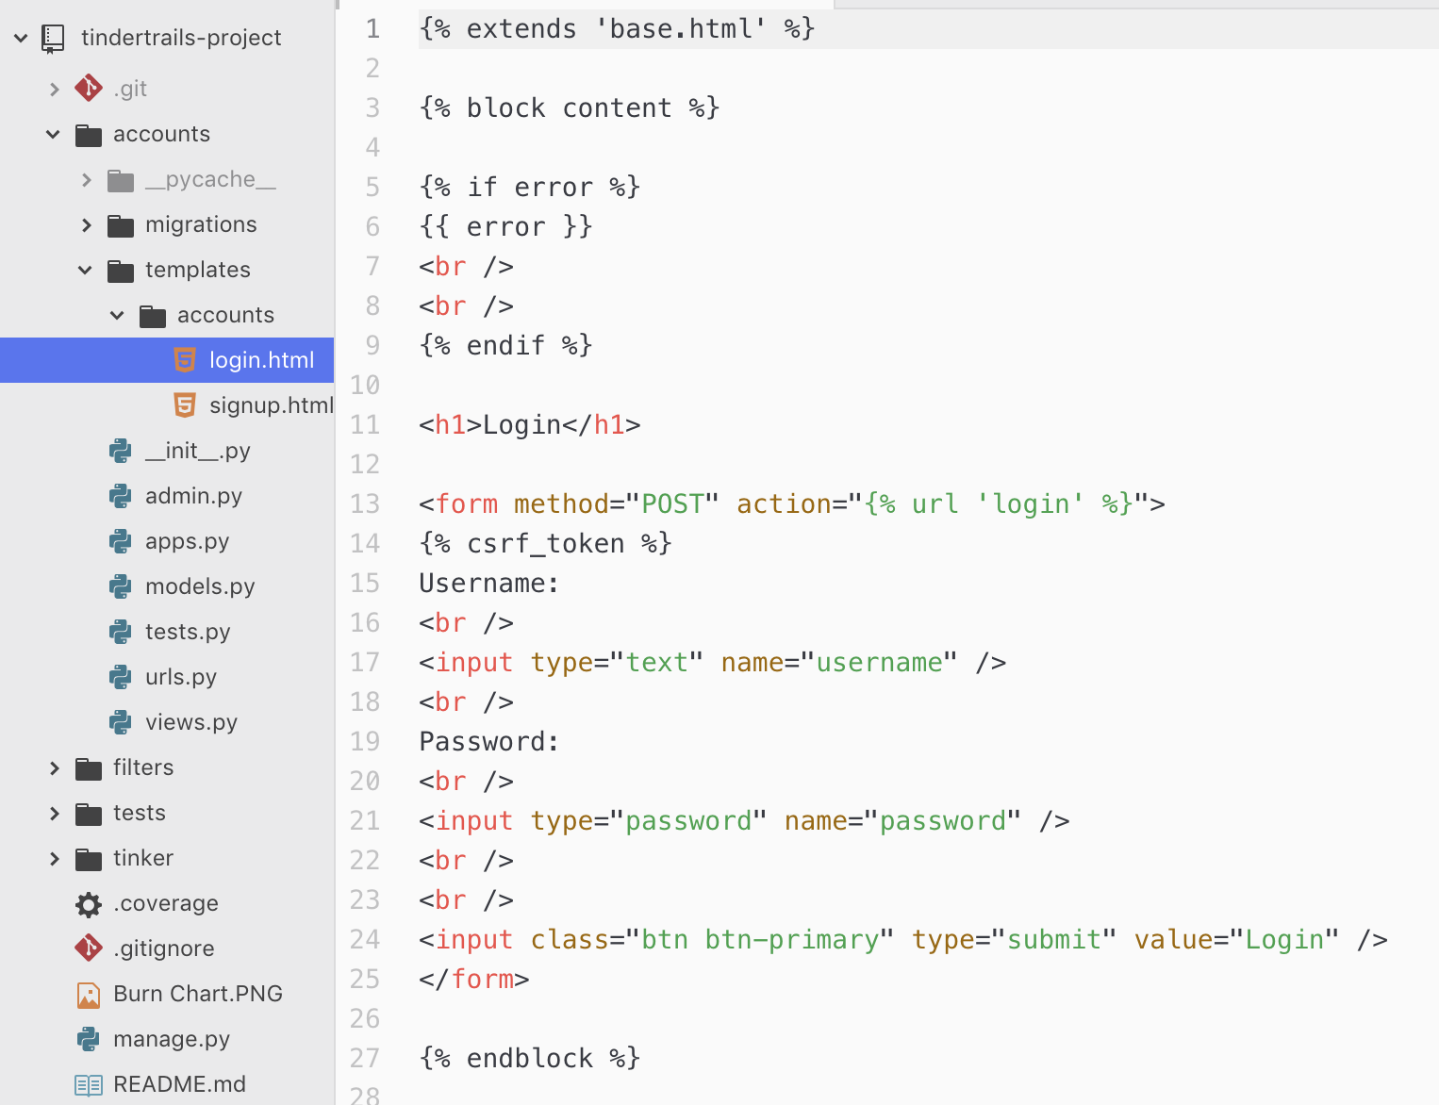
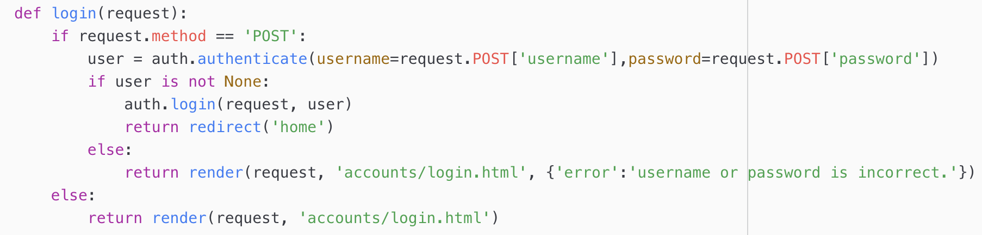
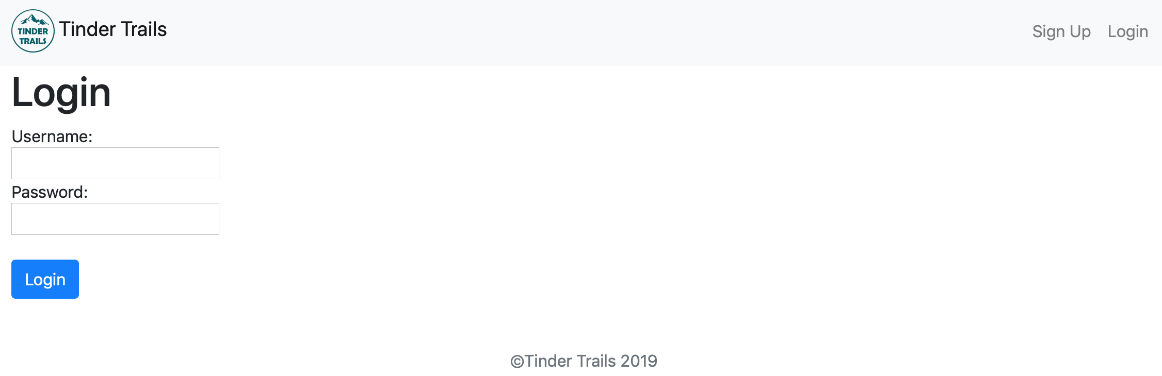
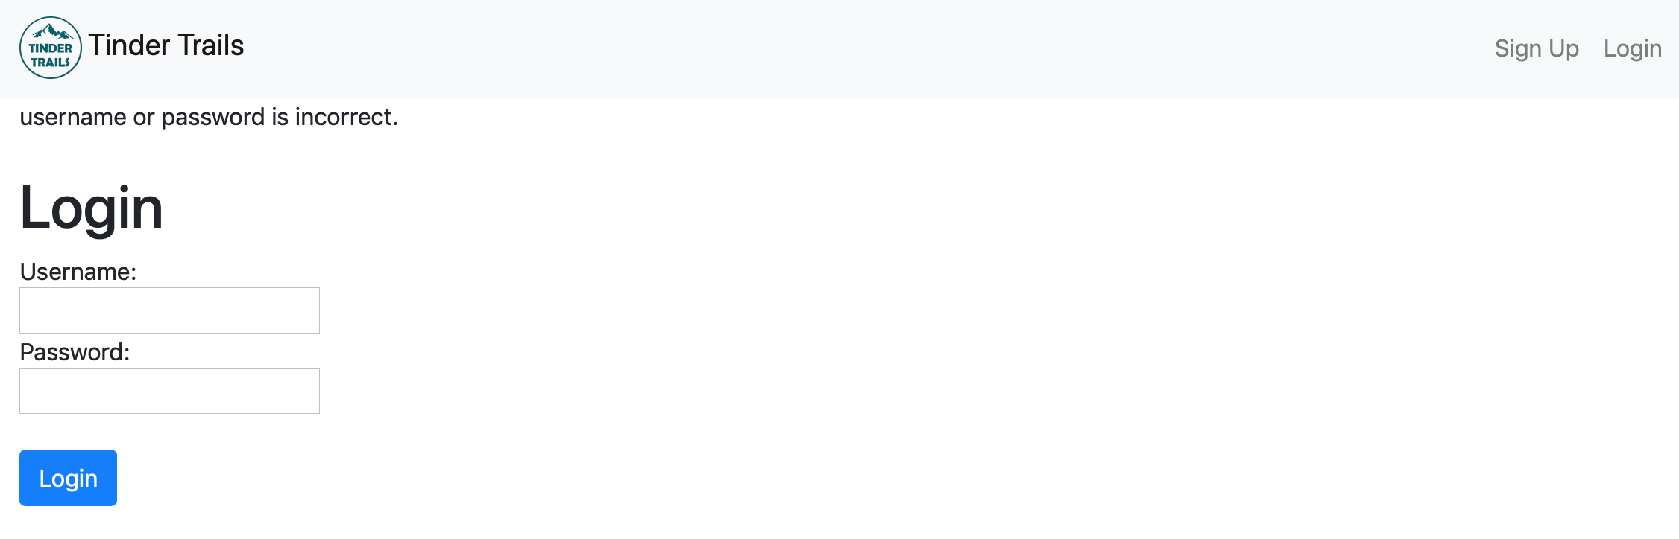
Django code walk through US_1a_Using Django to create sign up, login and log out US_1b_Send users back once they logged in or log out
Login
(tindertrails-project/accounts/templates/accounts/login.html)
(tindertrails-project/accounts/views.py)

Slide 14
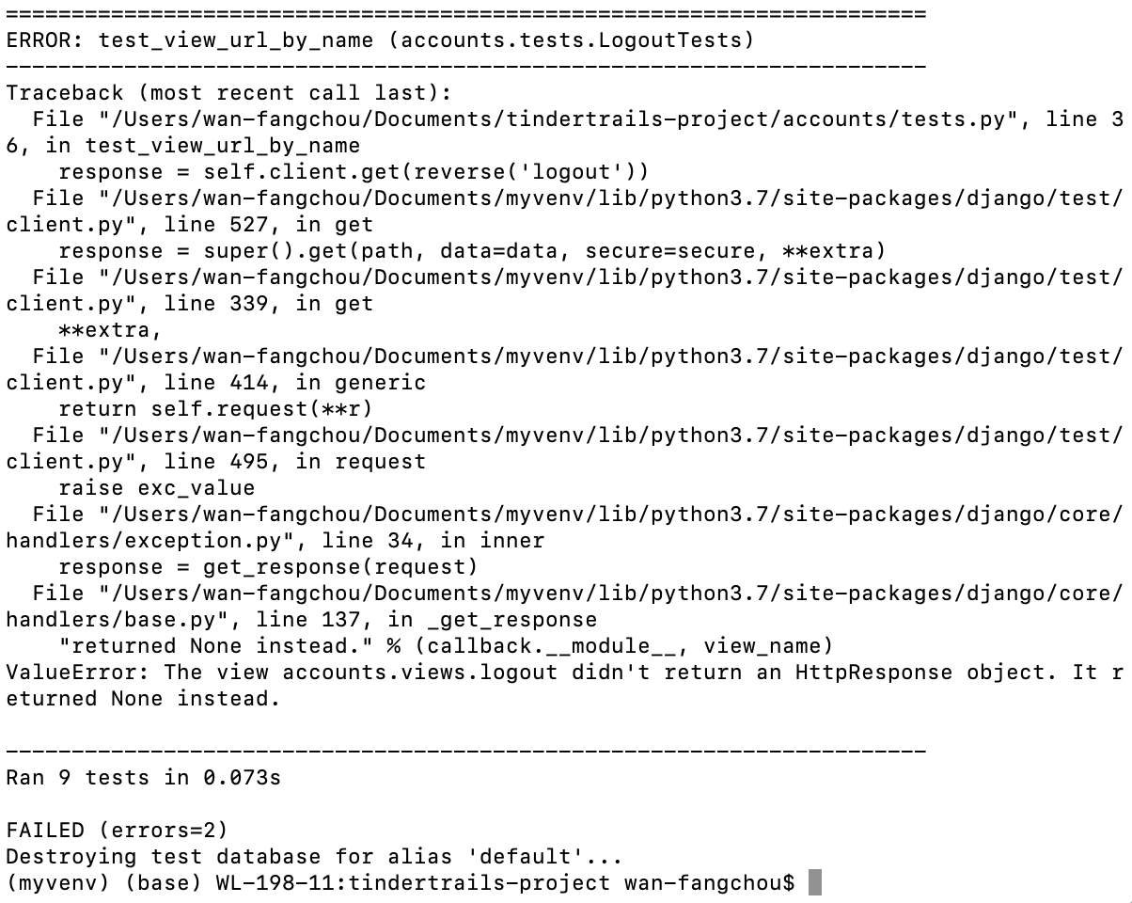
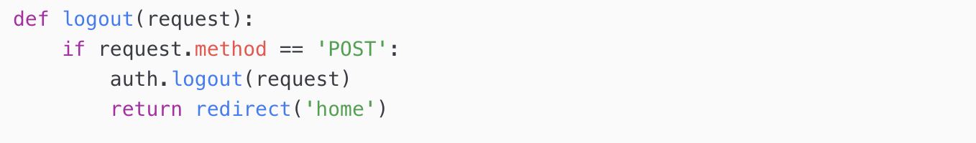
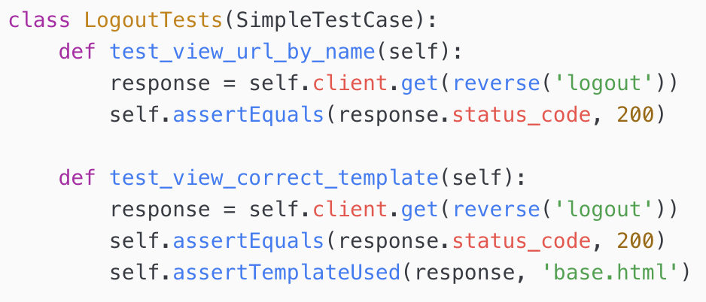
Django code walk through and test US_1a_Using Django to create sign up, login and log out US_1b_Send users back once they logged in or log out
Log out
(tindertrails-project/accounts/views.py)
Test

Slide 15
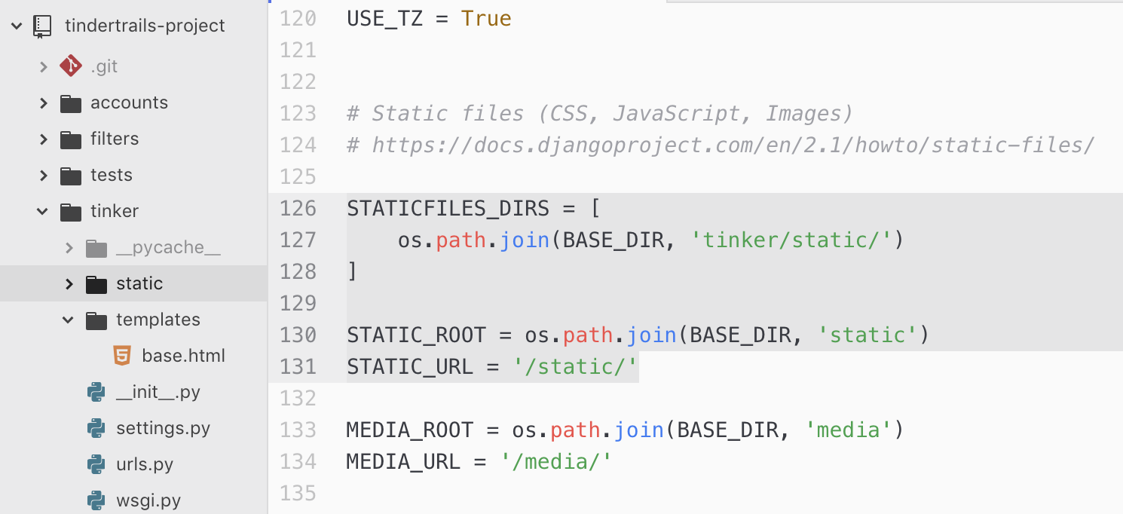
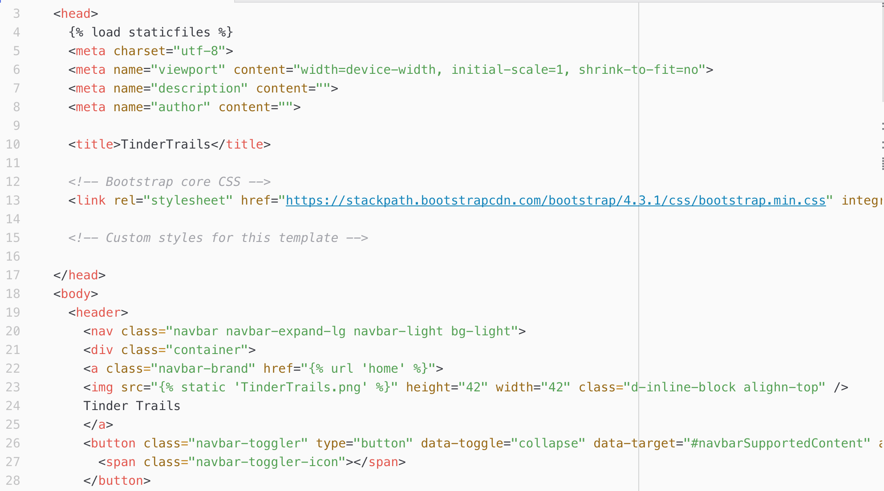
Django code walk through US_2g_The logo on the navigation bar could send users back to homepage
(tindertrails-project/tinker/settings.py)
(tindertrails-project/tinker/templates/base.html)

Slide 16
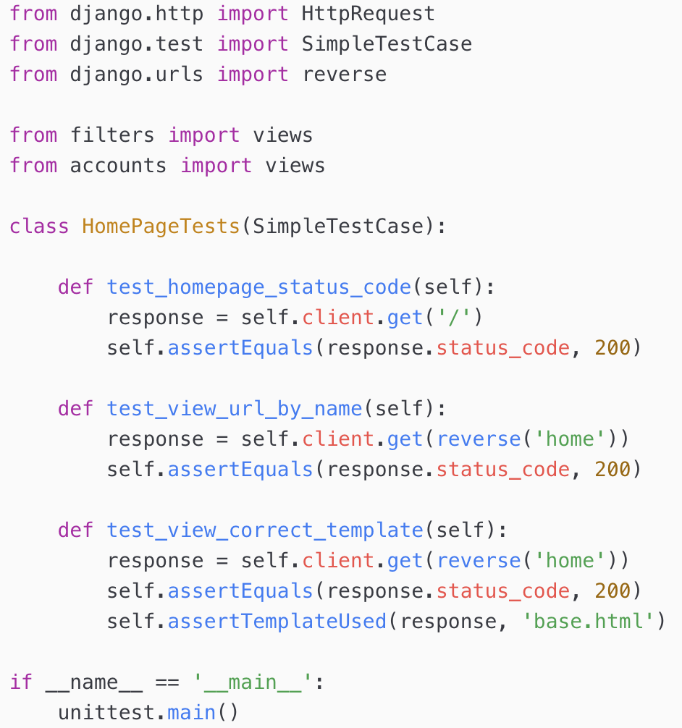
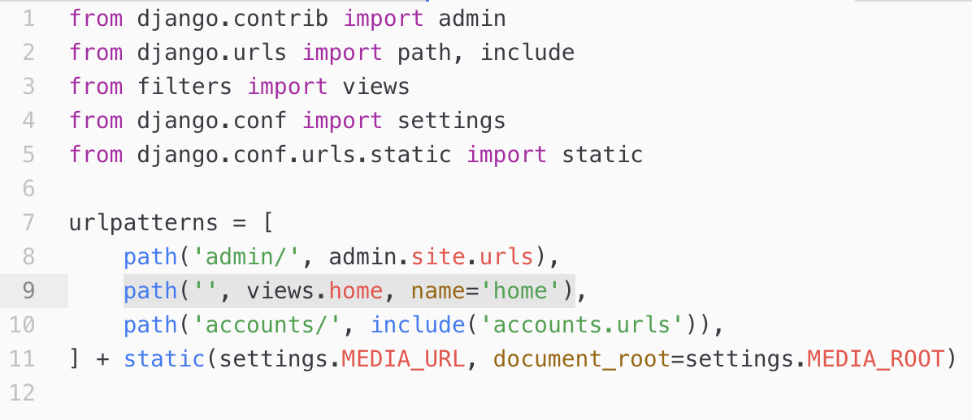
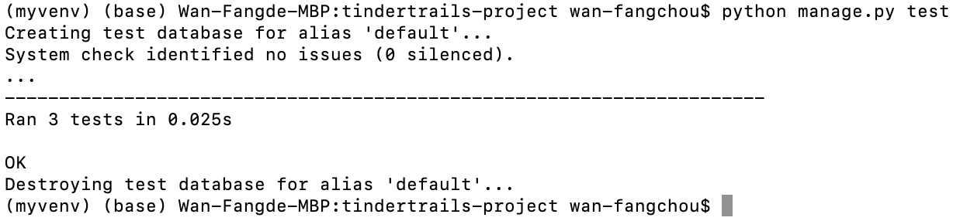
Django code walk through US_2a_On homepage, create find trails near me button and link to ArcGIS
Homepage url: http://165.22.132.51
(tindertrails-project/tinker/tests.py)
(tindertrails-project/tinker/urls.py)

Slide 17
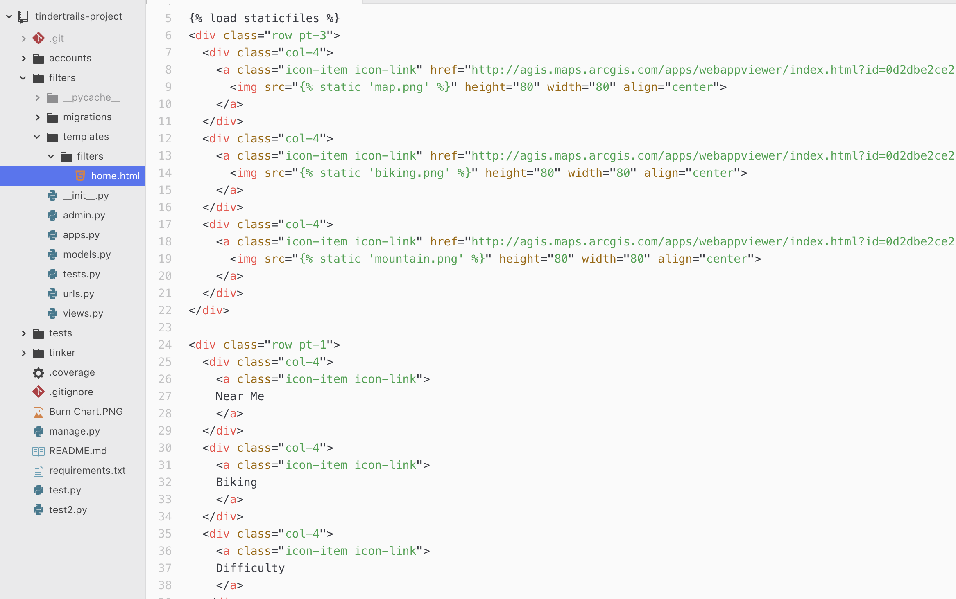
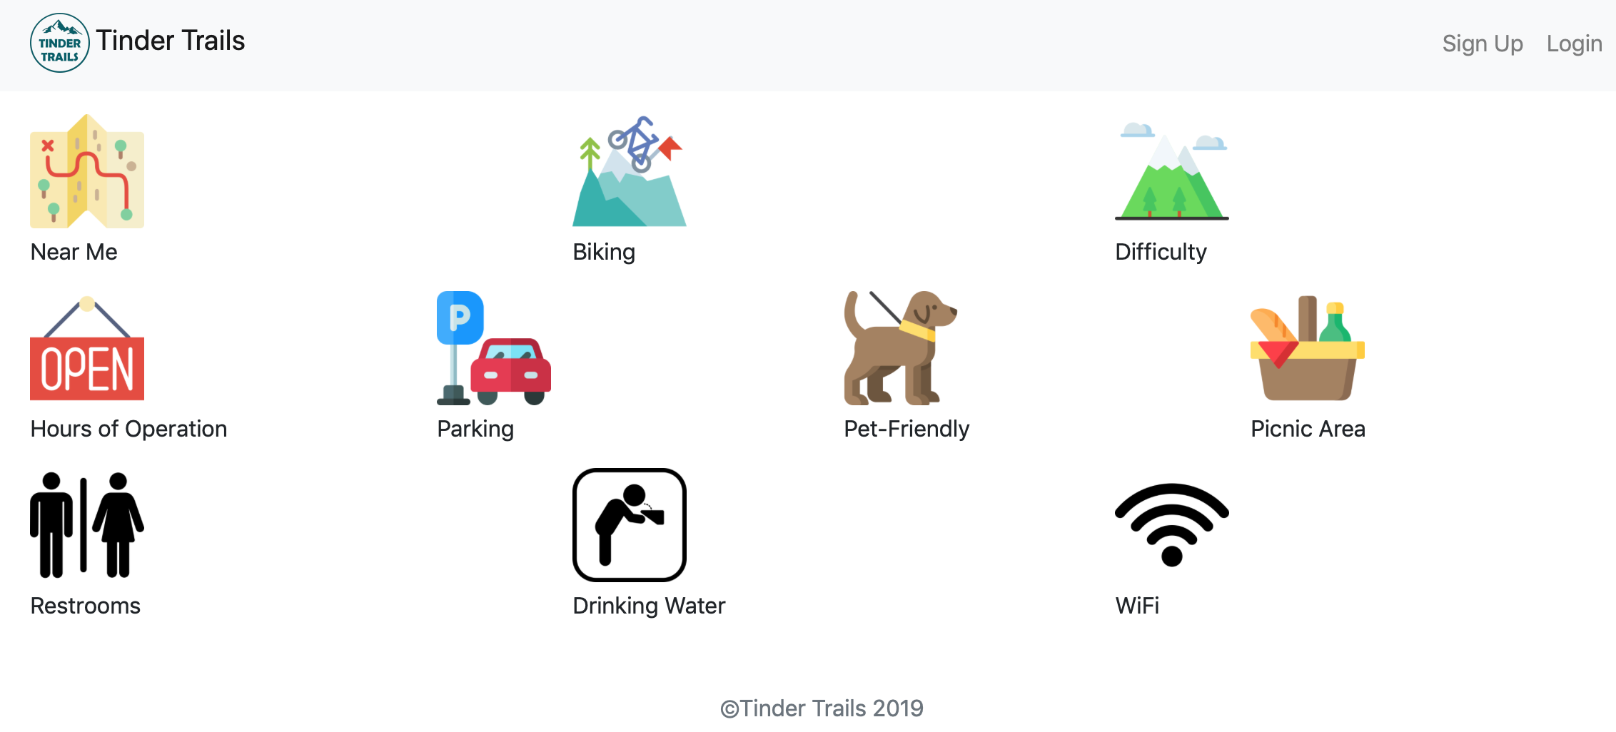
Django code walk through and test US_2a_On homepage, create find trails near me button and link to ArcGIS
Icons on homepage

Slide 18

Deploy Dejango app
http://165.22.132.51/

Slide 19
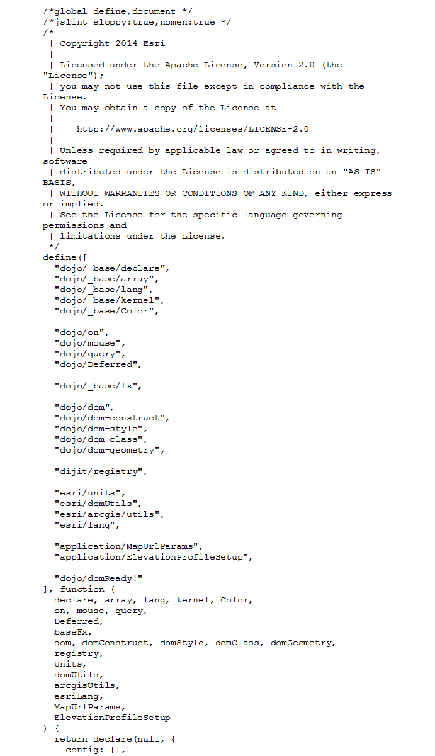
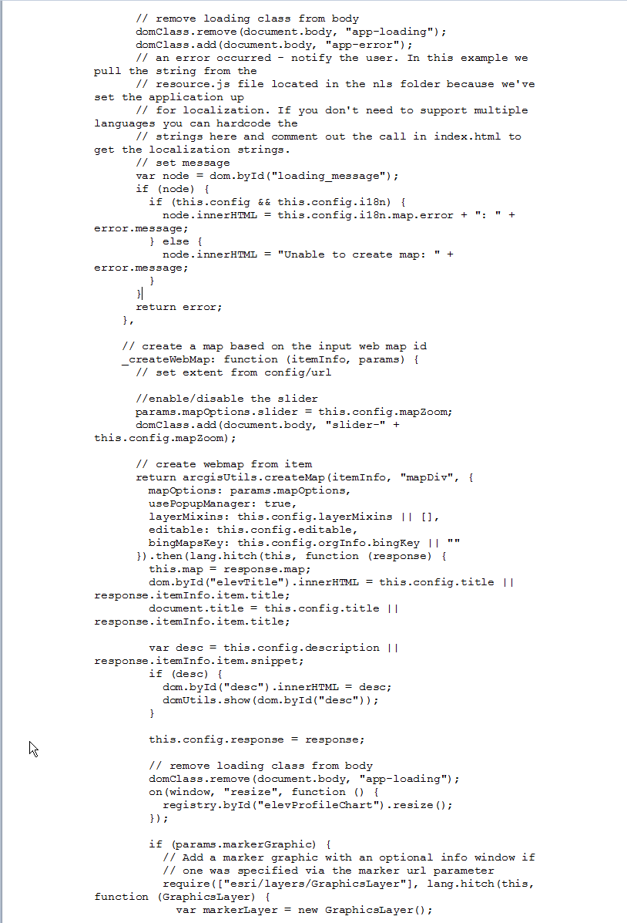
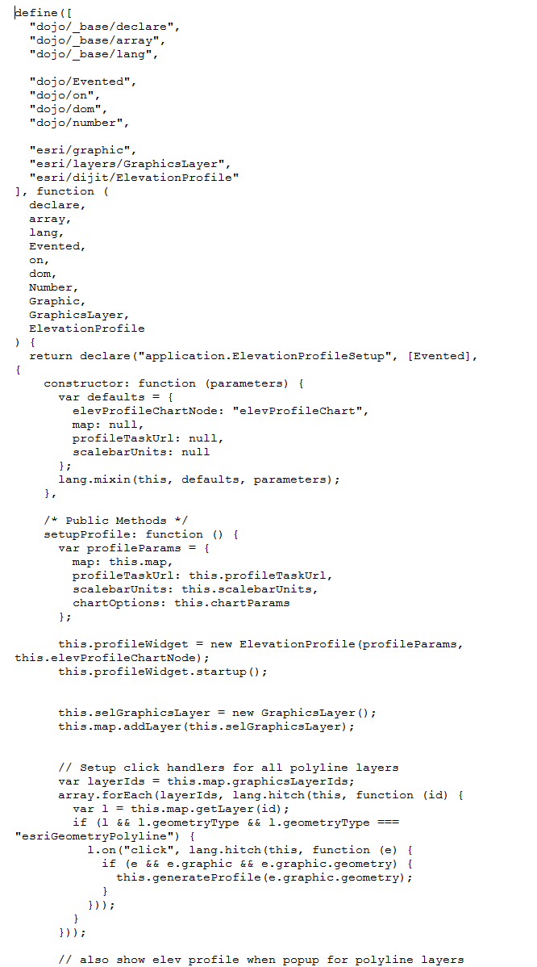
Hiking Trails
code
Walk through

Slide 20
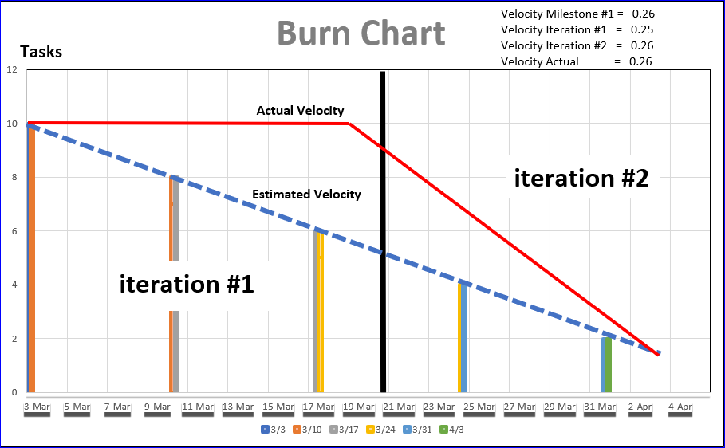

Slide 21
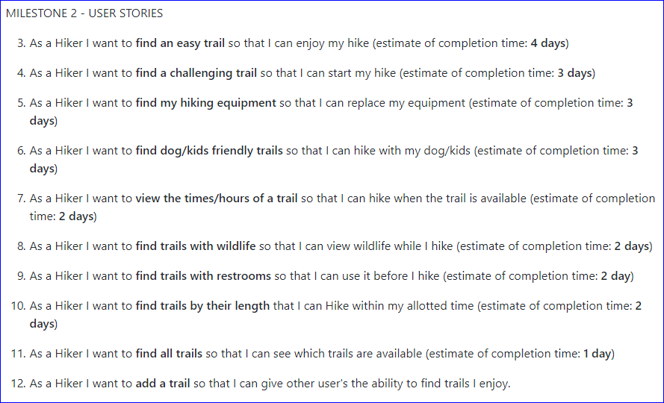
Milestone #2

Slide 22
Milestone #1 Reflections
Don’t commit to schedule when you’ve never used parts of the environment you’ll be using
Don’t be afraid to learn new things even if you thought that was impossible.
Welcome Changing Requirements Event Late in Development.

Slide 23
Q&A

